Slide 1
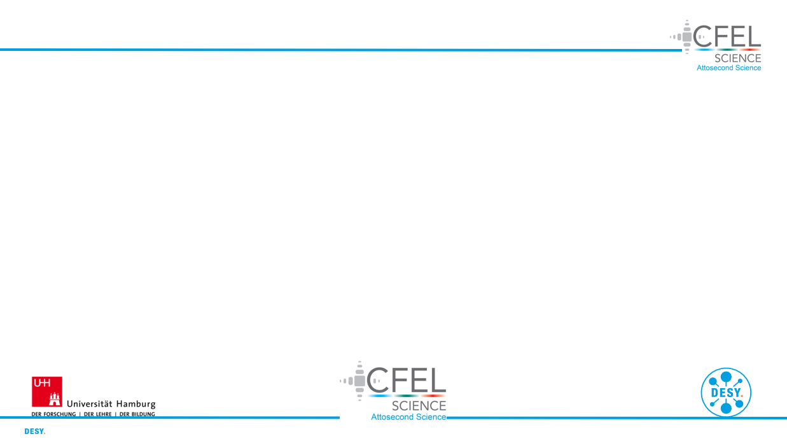
Modelling of nonlinear light up-conversion from intense femtosecond laser pulses
DESY Summer Student Programme 2023
Project Presentation
Group: CFEL-ATTO
Supervisor: Josina Hahne
David Amorim (University of Glasgow)

Slide 2
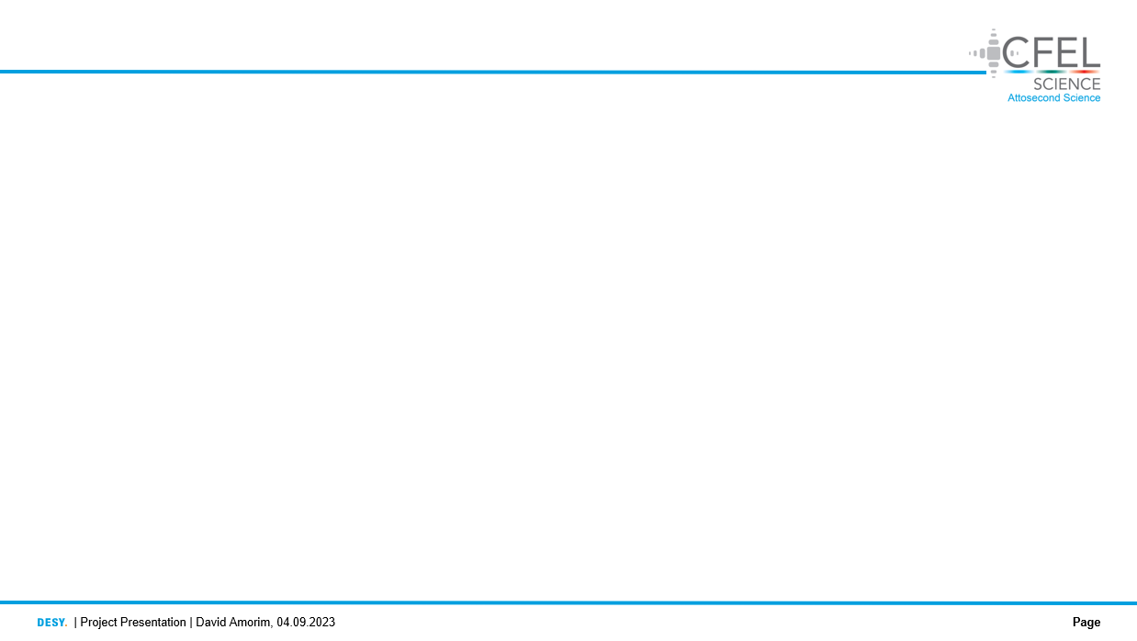
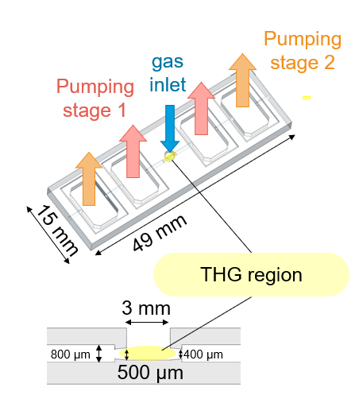
1. Motivation
The CFEL-ATTO group uses THG of few-femtosecond IR laser pulses in a gas cell to produce ultrashort UV pulses
The aim of this project was to produce simulations of the THG process to:
Reproduce the experimental conditions in the gas
Study the effects and parameters shaping the THG process
Compare the new gas chip to the old (2019) cell
Fig. 1: the fused silica chip used for gas confinement [CREDIT JOSINA]

Slide 3

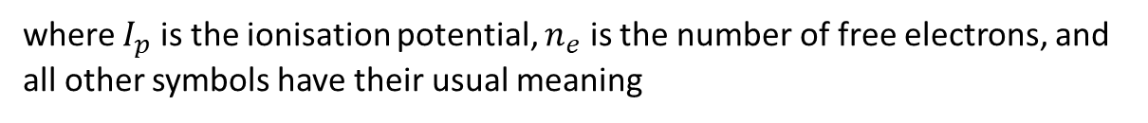
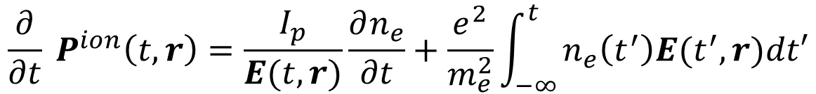

2. Background
The simulations were produced using the Luna.jl package [1]
Luna numerically solves the unidirectional pulse propagation equation (UPPE), which is derived from Maxwell’s Equations without employing a slowly-varying envelope approximation [2]
The nonlinear polarisation response in Luna considers the Kerr effect as well as photo-ionisation: $P^{NL}=P^{Kerr}+P^{ion}$, with
$$P^{Kerr}\left(t, r\right)=χ^{\left(3\right)}{\left[E(t,r)\right]}^{3}$$
(1)
$${\frac{∂}{∂t} P}^{ion}\left(t,r\right)=\frac{I_{p}}{E(t,r)}\frac{∂n_{e}}{∂t}+\frac{e^{2}}{m_{e}^{2}}\int_{−∞ }^{t}{n_{e}\left(t^{′}\right)E(t^{′},r)dt′}$$
(2)
where $I_{p}$ is the ionisation potential, $n_{e}$ is the number of free electrons, and all other symbols have their usual meaning

Slide 4
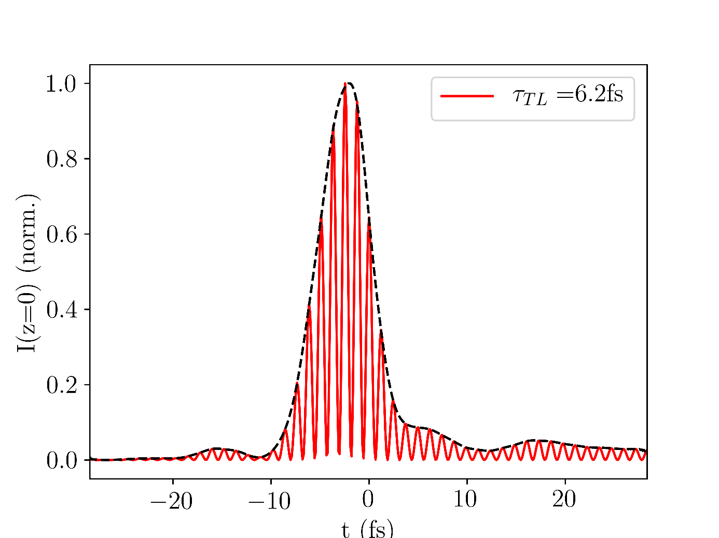
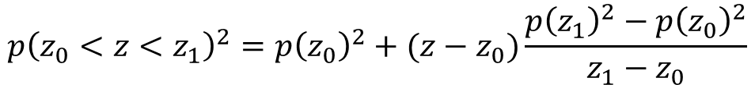
3. Simulation inputs
The simulation input is based on measured data, as far as possible
Time-intensity data of the IR input beam is read in
The spatial profile of the input beam is assumed to be a Gaussian
The gas density profile in the central interaction region is approximated using a gradient model:
While a variety of gases, pressures, and input powers can be simulated this presentation focusses on Argon and Neon
Fig. 2: NIR input pulse in the time domain
$$p{\left(z_{0}<z<z_{1}\right)}^{2}=p{\left(z_{0}\right)}^{2}+(z−z_{0})\frac{p{\left(z_{1}\right)}^{2}−p{\left(z_{0}\right)}^{2}}{z_{1}−z_{0}}$$
(3)
Fig. 3: gradient model of the gas distribution

Slide 5
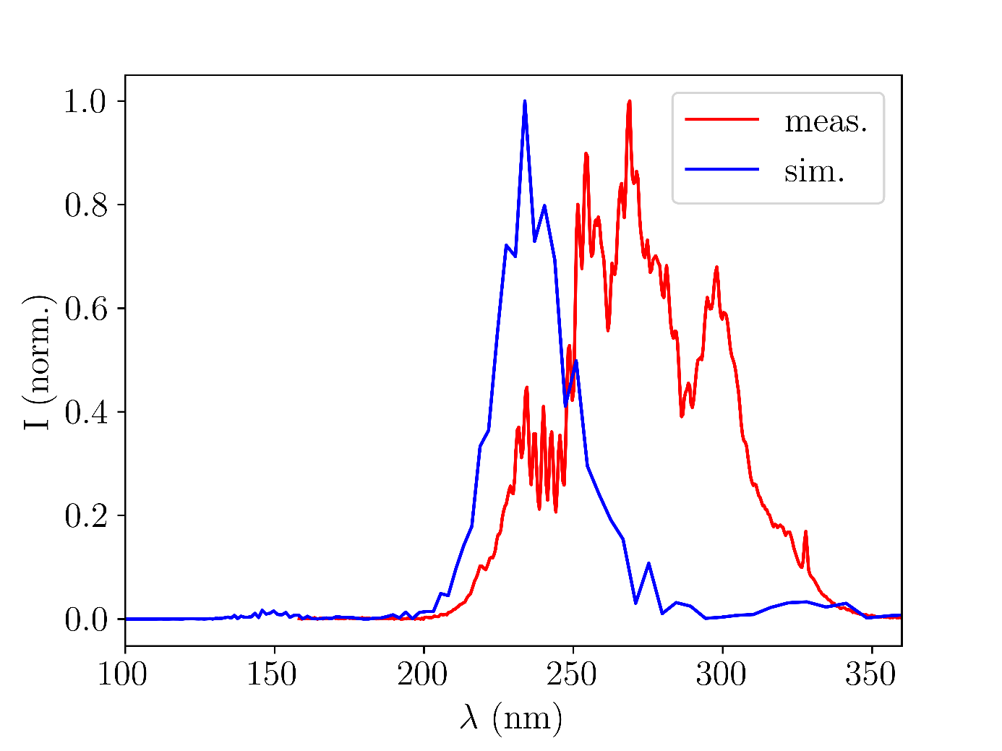
4.I Comparison with experiment
Accounting for pressure scale differences (factor 2.5), the simulated UV spectra agree well with experiment:
Fig. 4: UV output spectra for Argon with 150mW
input beam power and 0.4bar central pressure
Fig. 5: UV output spectra for Neon with 400mW input beam power and 2.0bar central pressure

Slide 6
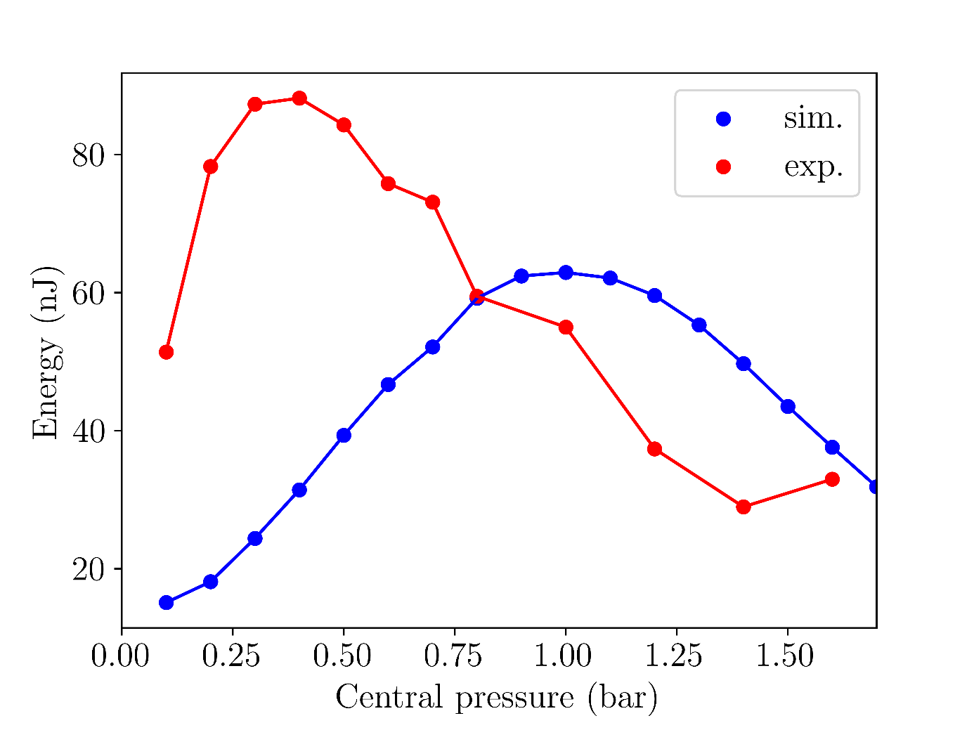
4.I Comparison with experiment
Using rescaled pressures, simulated UV energies qualitatively agree with experiments, although values differ by a factor of 10:
Fig. 6: UV output energies for Argon with 150mW
input beam power
Fig. 7: UV output energies for Neon with 400mW
input beam power

Slide 7
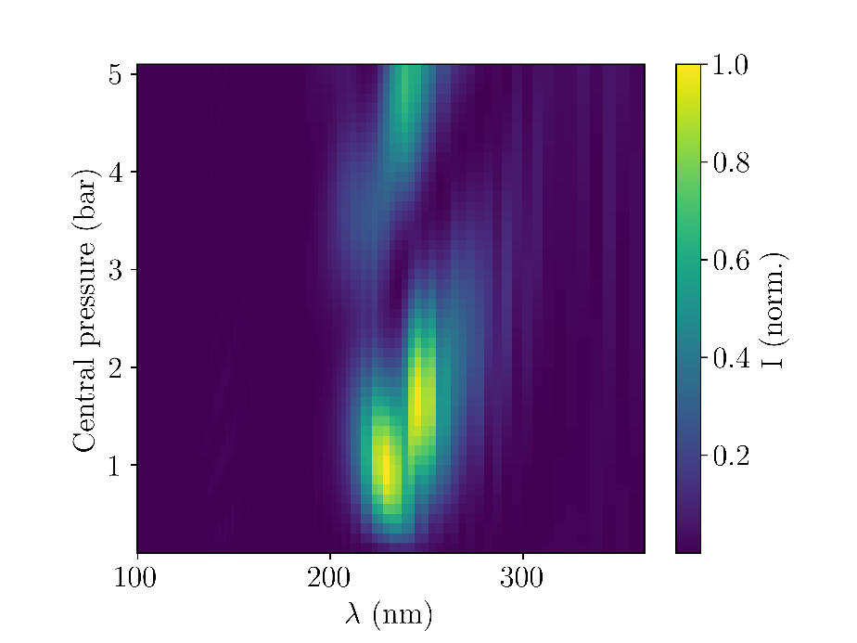
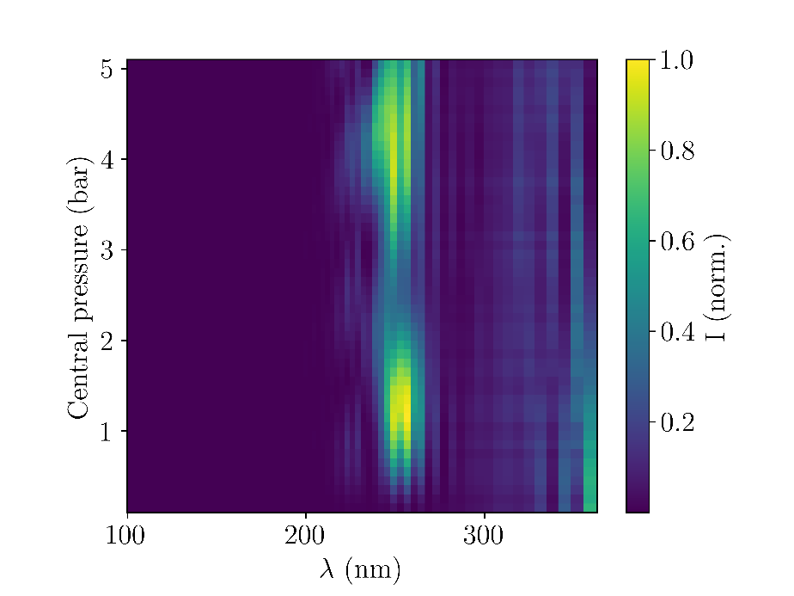
4.I Comparison with experiment
Using rescaled pressures, there is fairly good agreement with measured spectra across different pressures:
Fig. 8: UV output spectra at different central pressures. Left column: Argon (150mW), right column: Neon (400mW). Upper row: simulations, bottom row: measurements

Slide 8
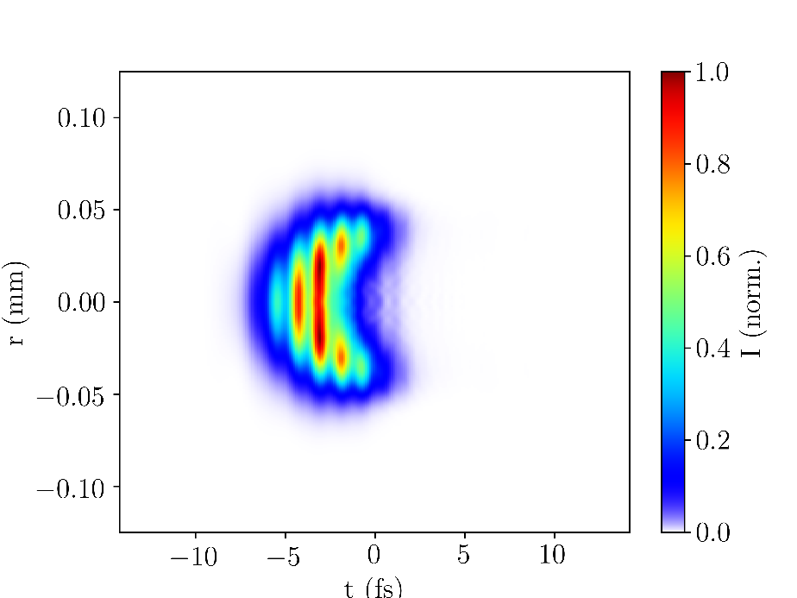
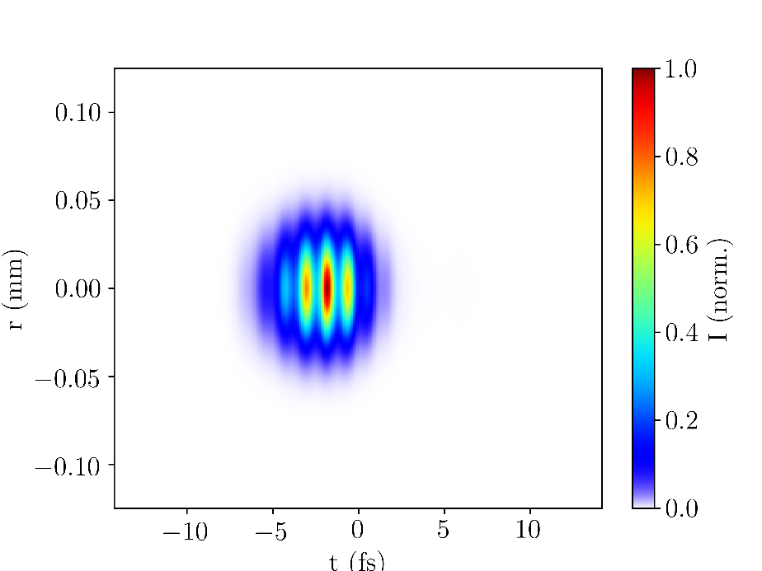
4.II Self-steepening
The simulations show that ionisation-induced self-steepening of the UV pulse contributes to pulse compression, in agreement with literature [3]:
Fig. 9: UV output beam with (left column) and without (right column) ionisation using Argon at 150mW and 0.4bar

Slide 9
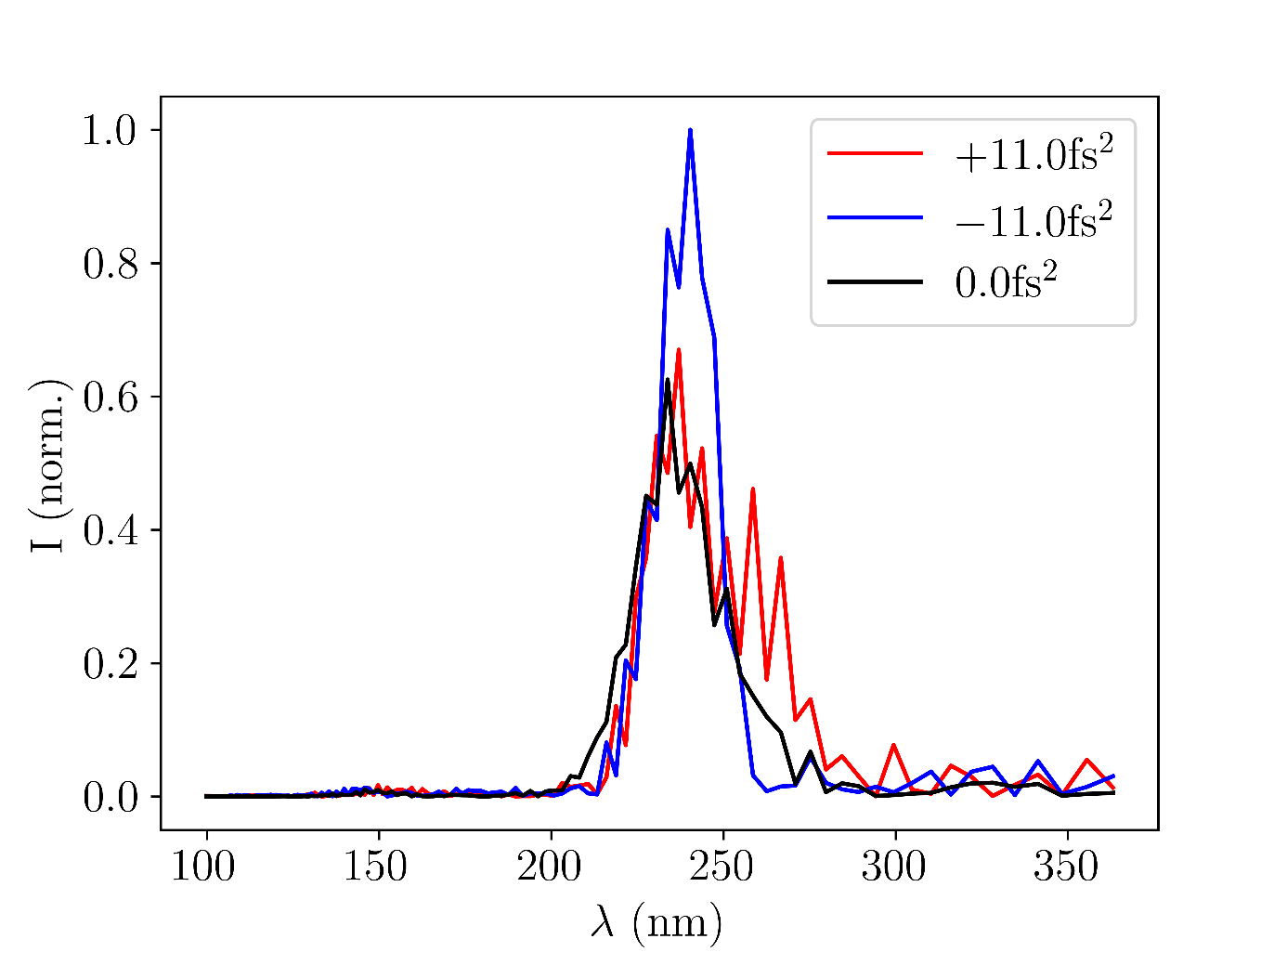
4.III Effects of chirp
The simulations indicate that using chirped input pulses could improve UV pulse properties:
Fig. 10: UV output spectra and temporal profiles for different GVD values of the input pulse. Left column: Argon, right column: Neon

Slide 10
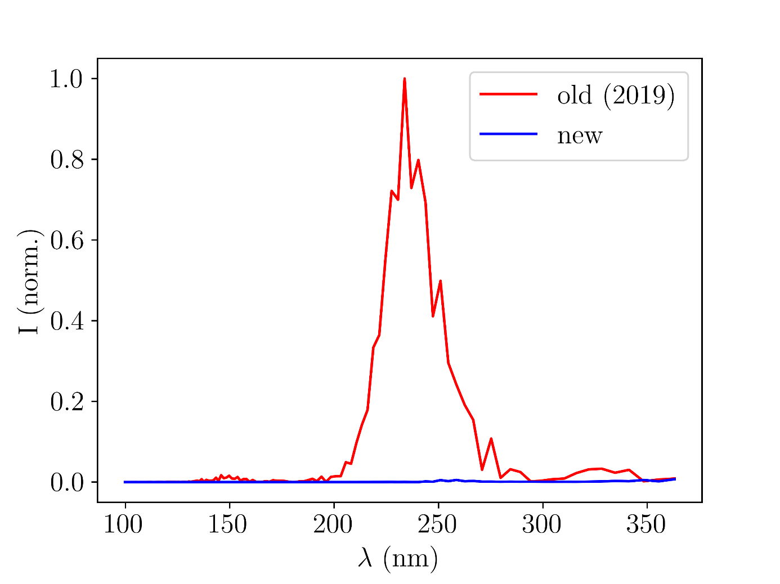
4.IV Comparing the gas cells
COMSOL simulations for the gas density distribution of the new and old cell were produced (by Josina Hahne):
Fig. 11: Gas density distributions in the old and new cell
Fig. 12: Comparison of gas distributions in the central interaction region

Slide 11
4.IV Comparing the gas cells
As expected, the simulations show the new chip to deliver broader and more intense UV spectra:
Fig. 13: UV output spectra with new and old gas cell for Argon at 150mW NIR power and 0.4bar central pressure
Fig. 14: UV output spectra with new and old gas cell for Argon at 400mW NIR power and 2.0bar central pressure

Slide 12
5. Discussion & conclusion
The THG simulations resulted in some promising outputs, showing agreement with both experiment and literature
There is significant room for further improvements
Use COMSOL simulations to model the gas distribution
Base the spatial profile of the input beam on measured data (this requires dropping the assumption of radial symmetry)
With additional expansions, the simulation code could serve as a basis to back up future experiments with theory

Slide 13
6. Acknowledgments & references
Acknowledgments
Thank you to Josina Hahne and Vincent Wanie for all their help with the project as well as to the rest of the CFEL-ATTO team for being so welcoming and friendly.
References
[1] C. Brahms and J. C. Travers, “Luna.jl,” (2023); https://doi.org/10.5281/zenodo.8242646
[2] M. Kolesik and J. V. Moloney, “Nonlinear optical pulse propagation simulation: From Maxwell’s to unidirectional equations,” Phys. Rev. E 70, 036 604 (2004)
[3] F. Reiter, U. Graf, et al. “Route to Attosecond Nonlinear Spectroscopy,” Phys. Rev. Lett. 105, 243 902 (2010)

